Slide 1
Pharmacy Management System

Slide 2
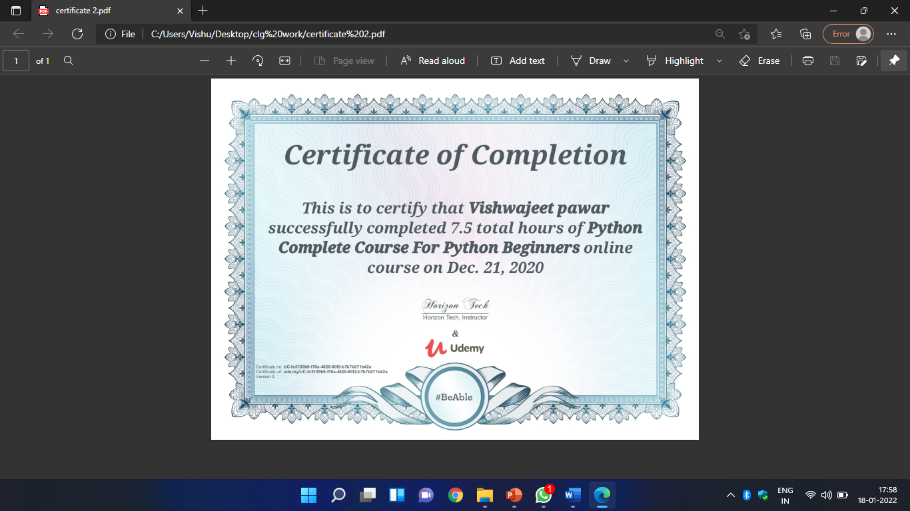

Slide 3
Introduction of Pharmacy Management System

Slide 4
The “Pharmacy Management System "has been developed to override the problems prevailing in the practicing manual system .This software is supported to eliminate and in some cases reduce the hardships faced by existing system. This system is designed for the particular need of the company to carry out operations in a smooth and effective manner .The application is reduced as much as possible to avoid errors while entering the data. It also provide error message while entering invalid data. Pharmacy Management System is secure ,reliable and fast management system. It can assist the user to concentrate on their other activities rather to concentrate on the record keeping. Thus it will help organization in better utilization of resources.

Slide 5
Objective and Purpose of the Project

Slide 6
The main objective of the project on Pharmacy Management System is to manage the details of Pharmacy , Medicines, Stocks, Company, Inventory . It manages all the information about Pharmacy,sells,inventory. The project is totally built at administrative end and thus only the administrator is guaranteed the access .The purpose of Pharmacy Management System is to automate the existing manual system by the help of computerized equipment's and full-fledged computer software ,fulfilling their requirements, so that their valuable data/information can be stored for a longer period with easy accessing and manipulation of the same. Basically the project describes how to manage for good performance and better service for the clients.

Slide 7
Functionalities Provided by Pharmacy Management System

Slide 8
* Provides the searching facilities based on various factors. Such as Pharmacy , Stock, Company, Inventory. * It tracks all the information of Medicines, sells etc. * Manage the information of medicines. * Editing, adding, delete and updating of records is improved which result in proper resource management of Pharmacy data. * Increase efficiency of managing the Pharmacy ,Medicines.

Slide 9
About the Project

Slide 10
Pharmacy Management System project is written in Python. The project file contains a python script and database files. This is a simple GUI based project which is very easy to understand and use. Talking about the system, it contains all the basic functions which include adding, viewing, deleting and updating items. In order to add a medicine detail, the user has to provide its name, price, quantity, category, and discount. This simple GUI based Pharmacy Management system provides the simplest management of medicine items. In short, this projects mainly focus on CRUD. There’s an external database connection file used in this mini project to save user’s data permanently.

Slide 11
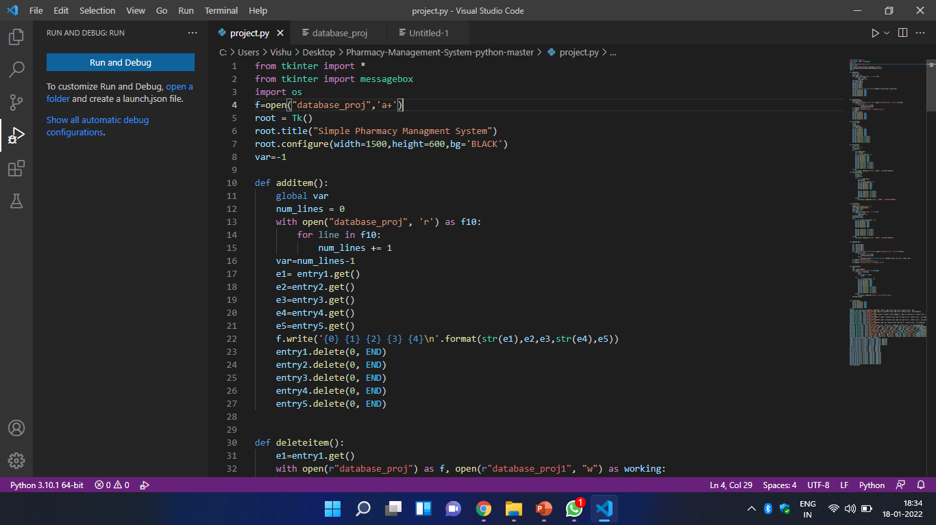

Slide 12
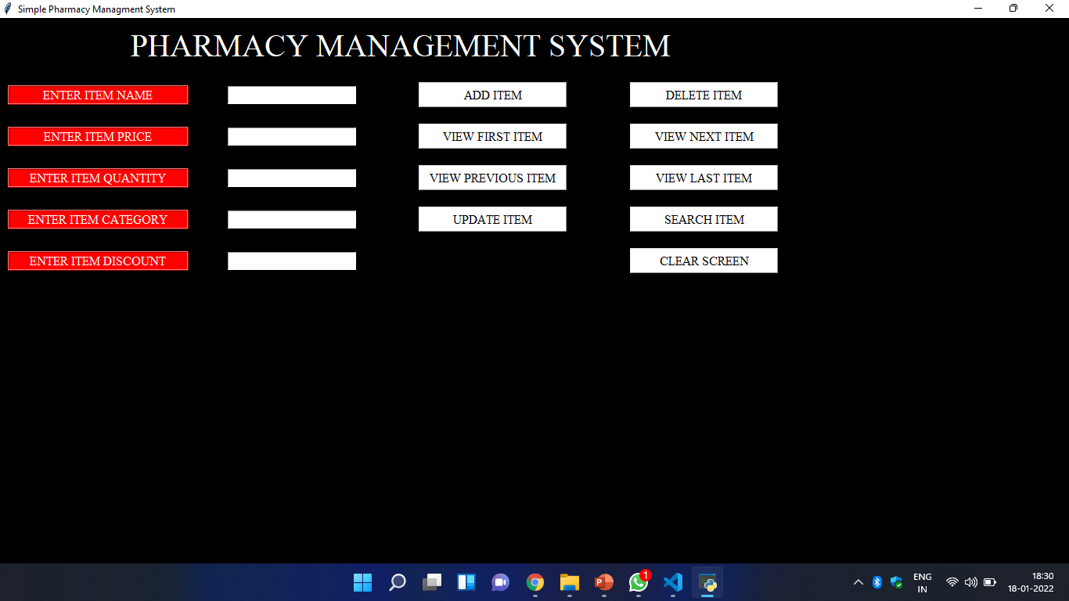

Slide 13
